Slide 1
Day 17
Combining Two Noisy Measurements

Slide 2
Probability Density Function
the probability that a random variable X takes on a value between a and b is
f (x) is called the probability density function and it is constrained by

Slide 3
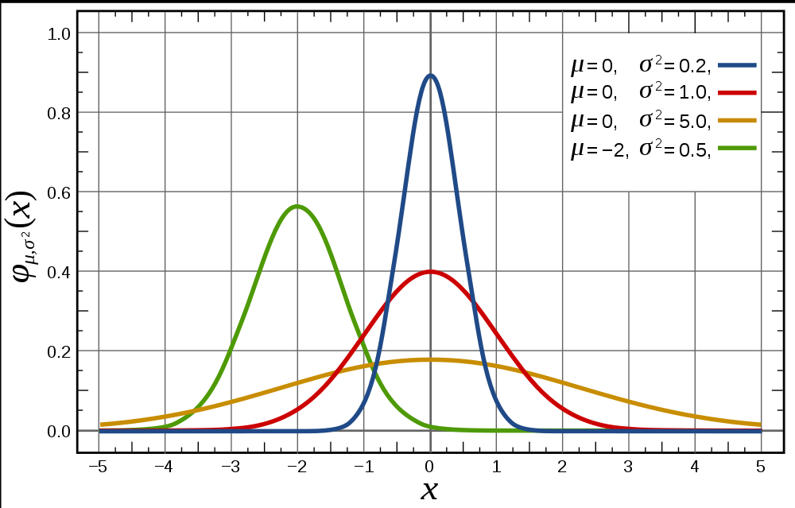
Normal (Gaussian) Density Function

Slide 4
Expected Value
informally, the expected value of a random variable X is the long-run average observed value of X
formally defined as
properties

